Slide 1


Unit 3: Lesson 9
What’s your passion?

Slide 2


Slide 3
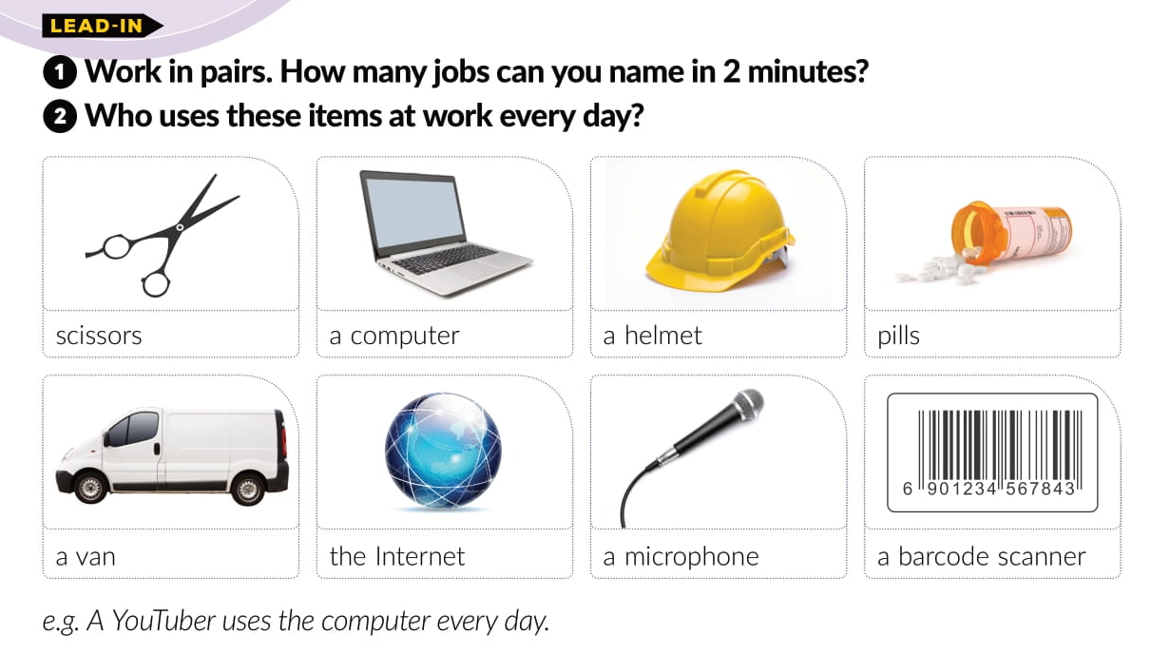

Slide 4

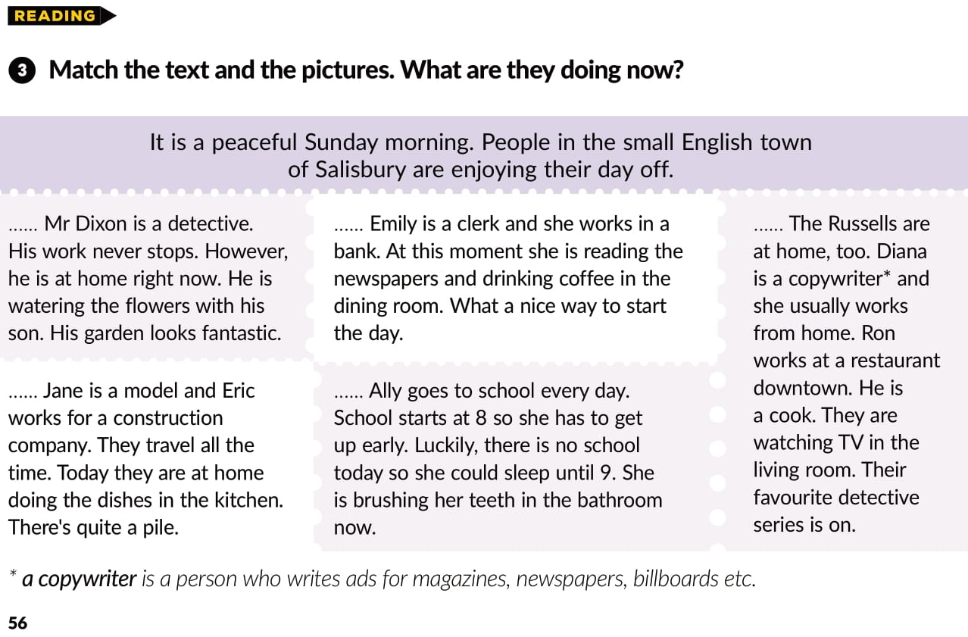
1
4
5
3
2

Slide 5
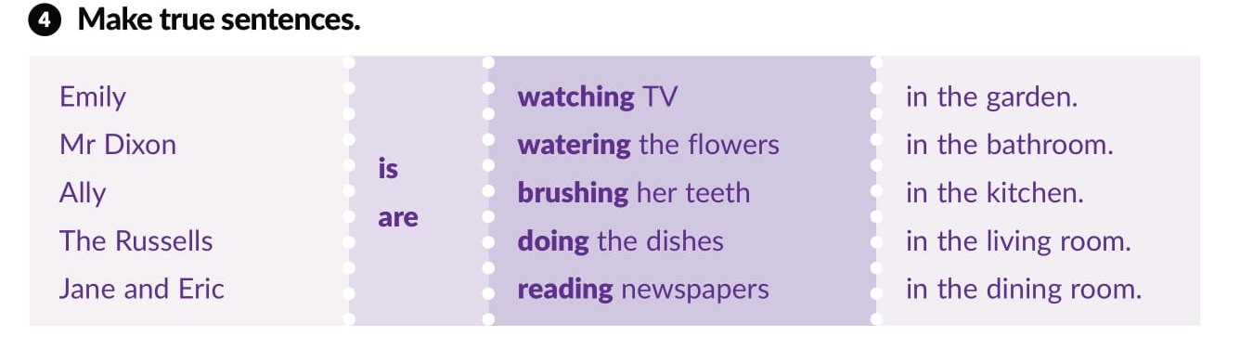

Slide 6
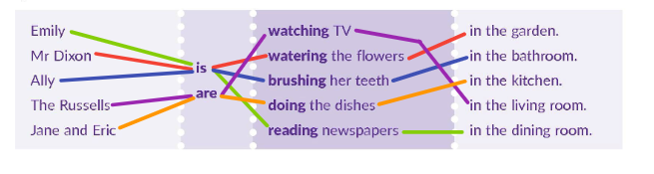
Check!

Slide 7
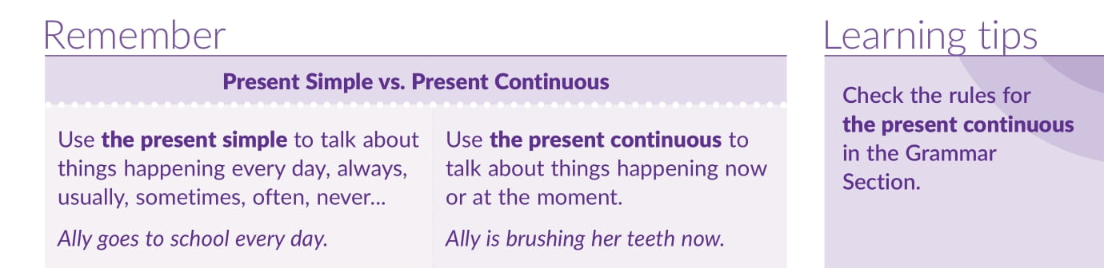

Slide 8


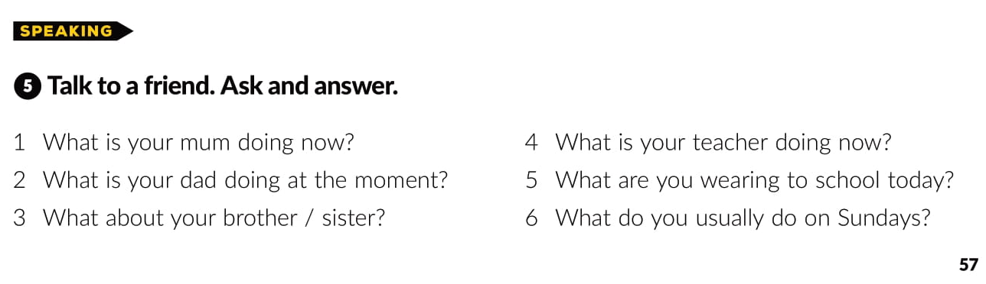

Slide 9
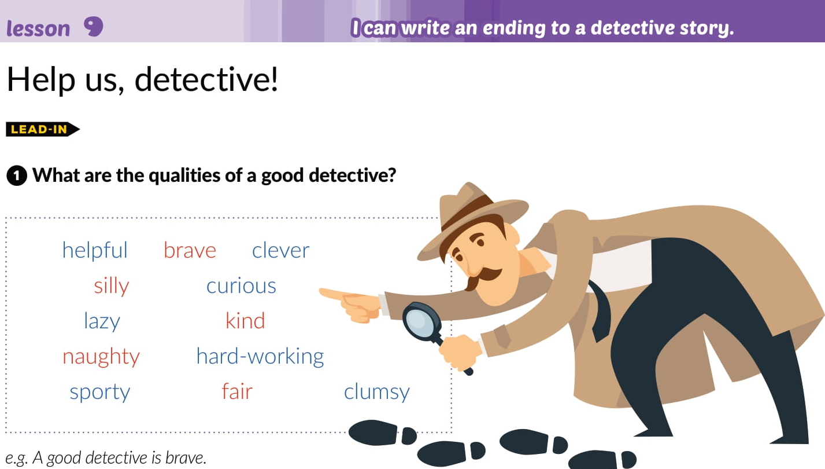

Slide 10

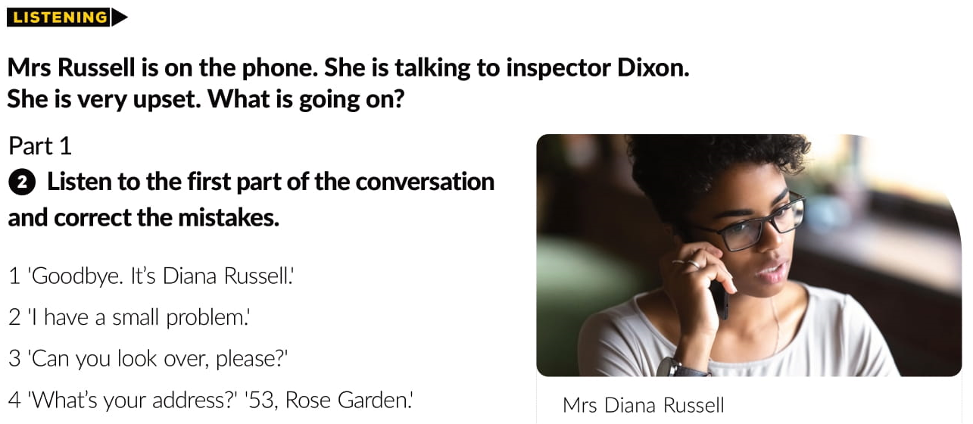
Hello.
big
Help me
35.

Slide 11
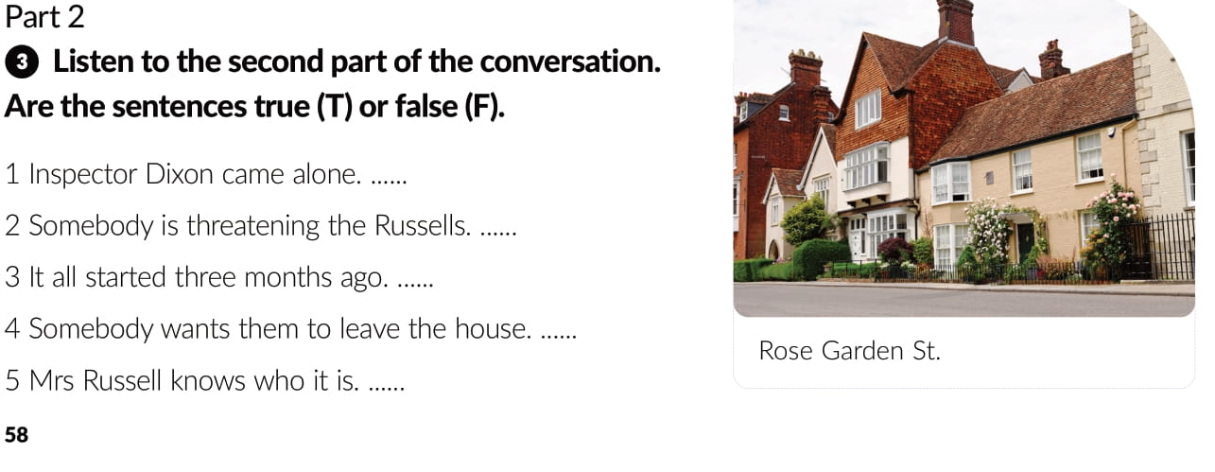
F
T
F
T
F

Slide 12
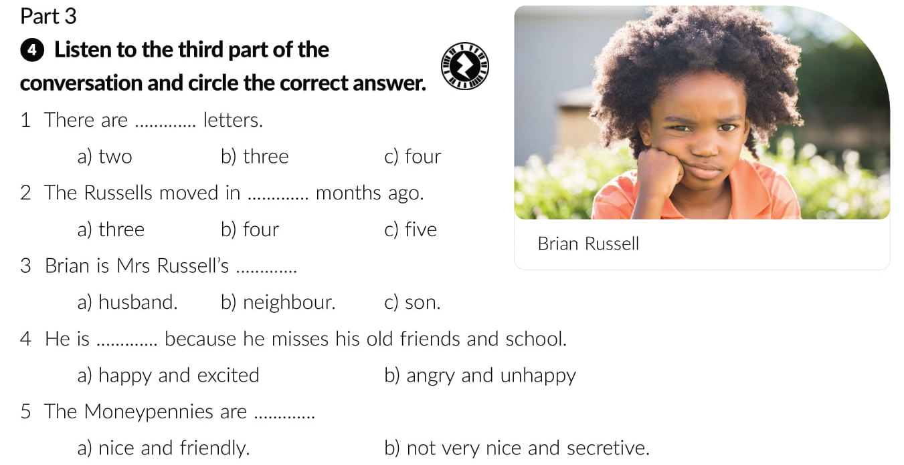

Slide 13
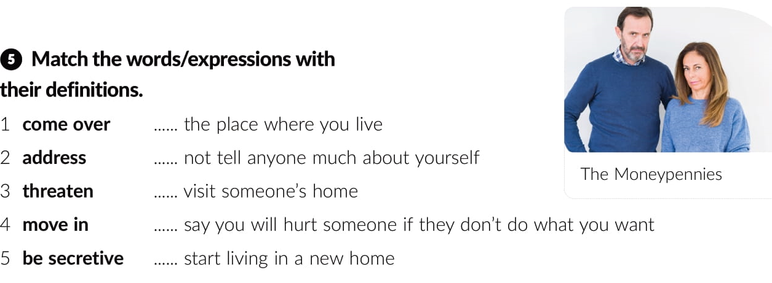
2
5
1
3
4

Slide 14
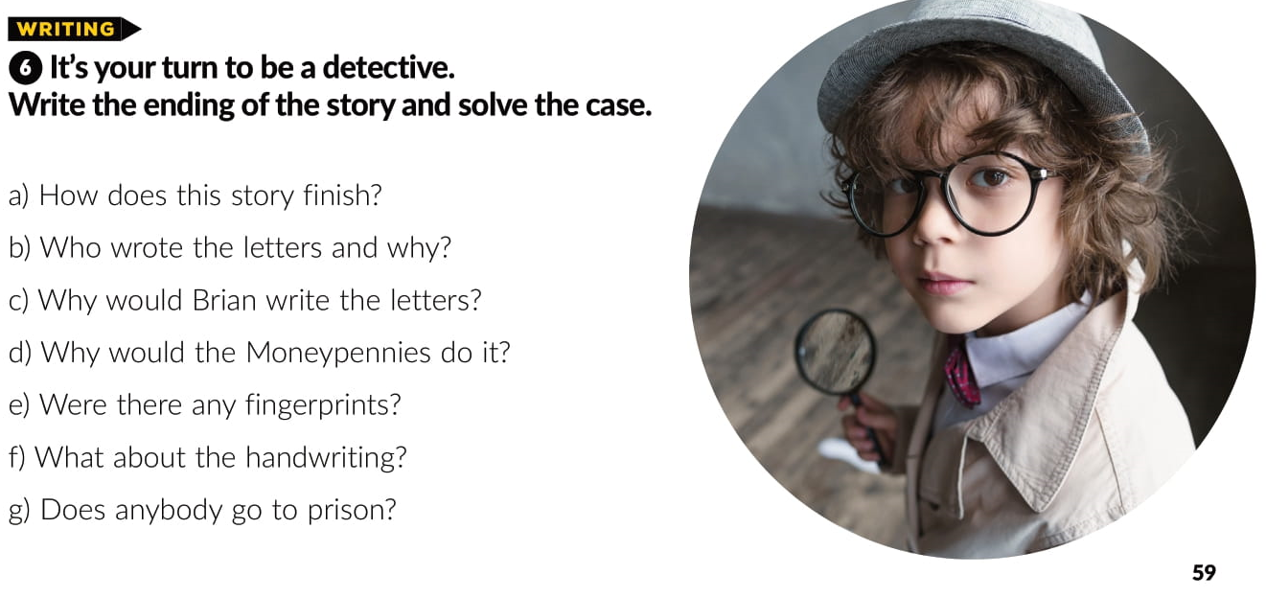

Slide 15
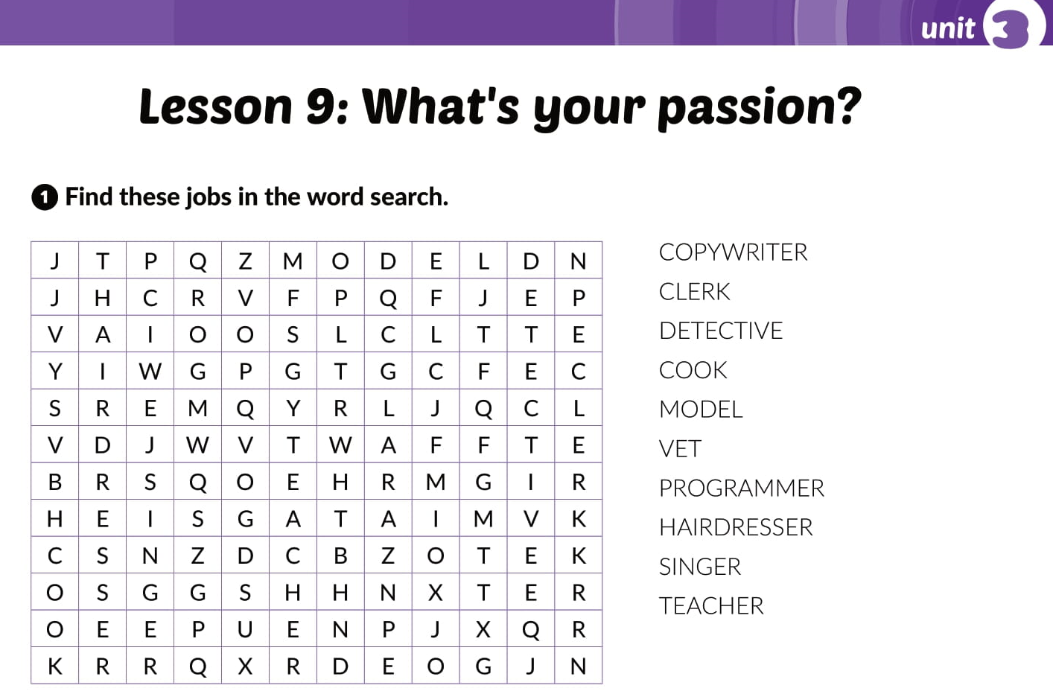
Workbook, p. 41

Slide 16
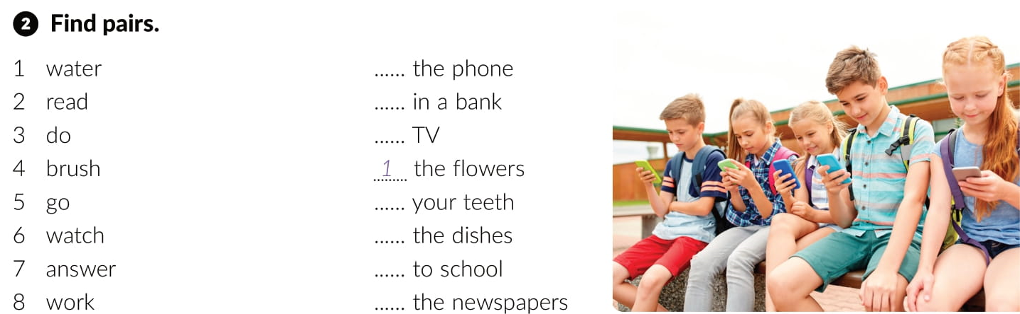
7
8
6
4
3
5
2

Slide 17
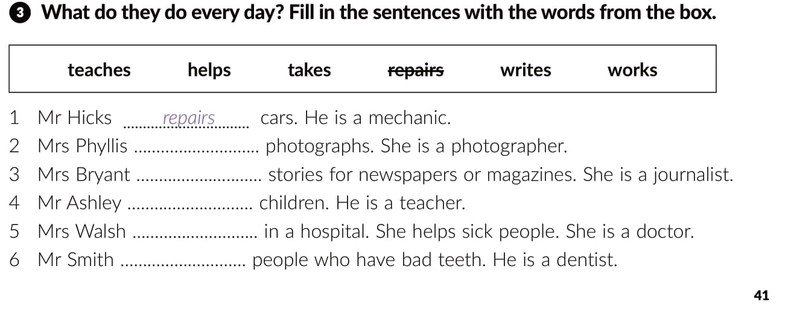
takes
writes
teaches
works
helps

Slide 18



Slide 19
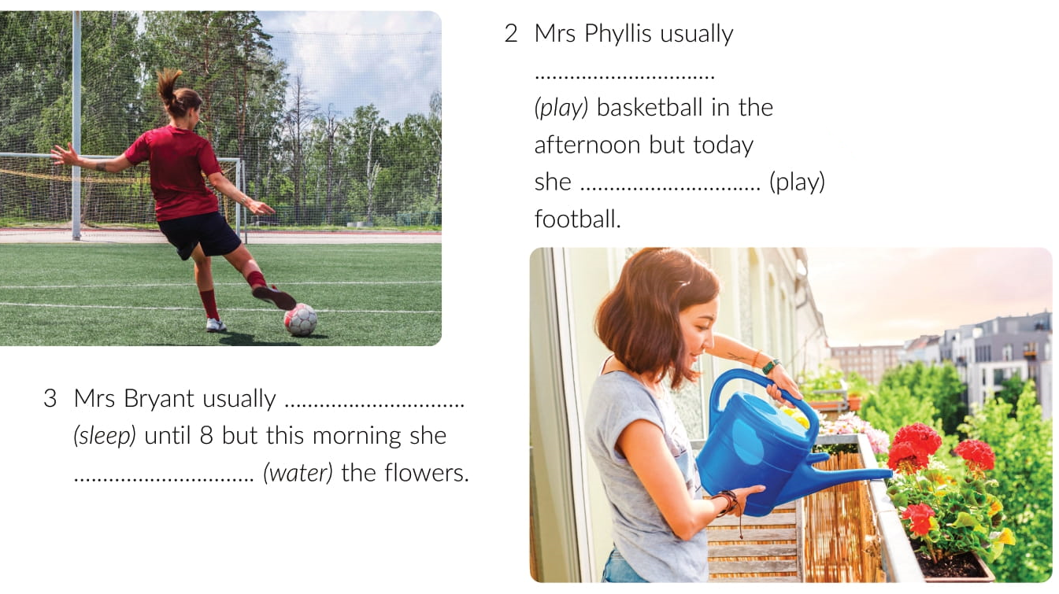
plays
is playing
sleeps
is watering

Slide 20
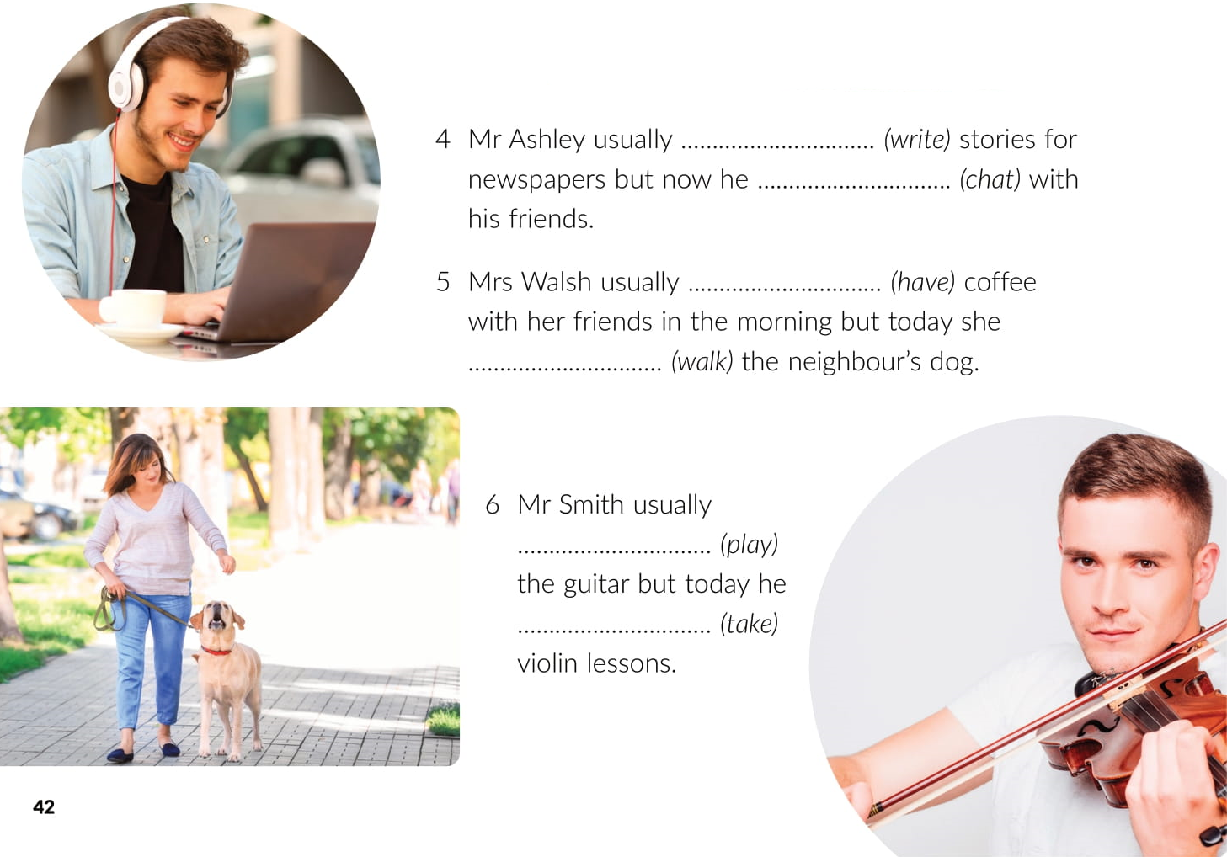
writes
is chatting
has
is walking
plays
is taking

Slide 21
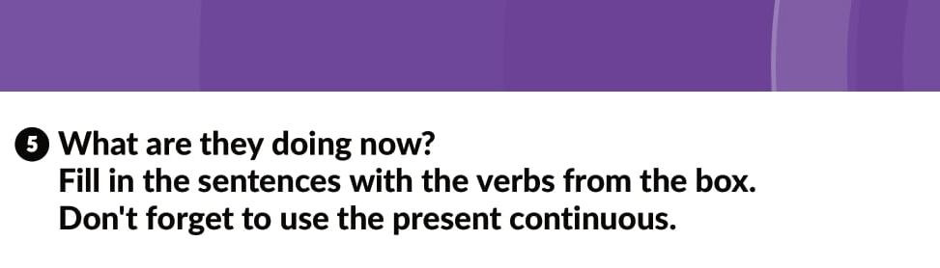
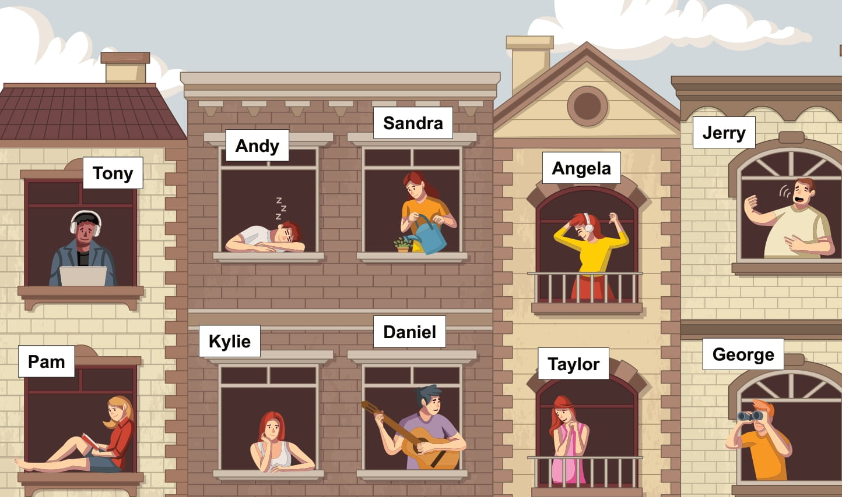
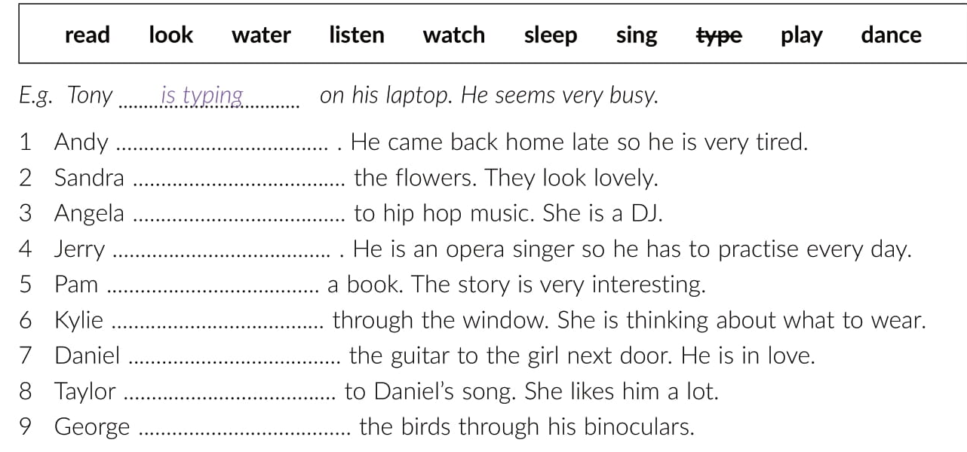
is sleeping
is watering
is dancing
is singing
is reading
is looking
is playing
is listening
is watching

Slide 22
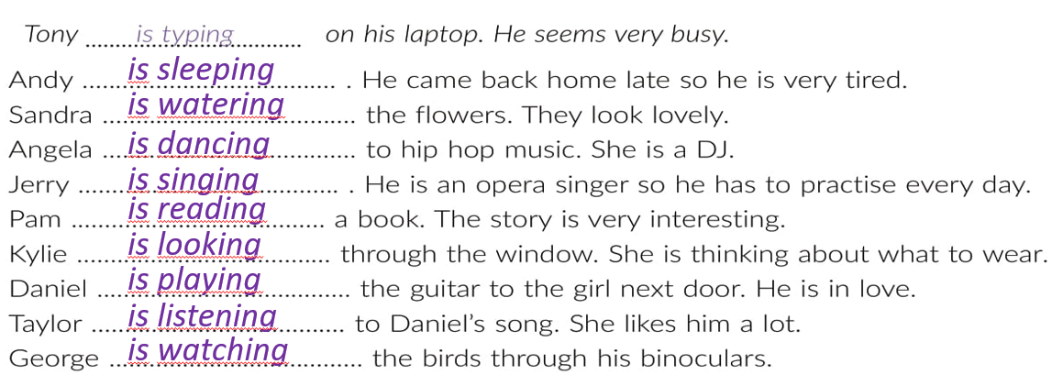
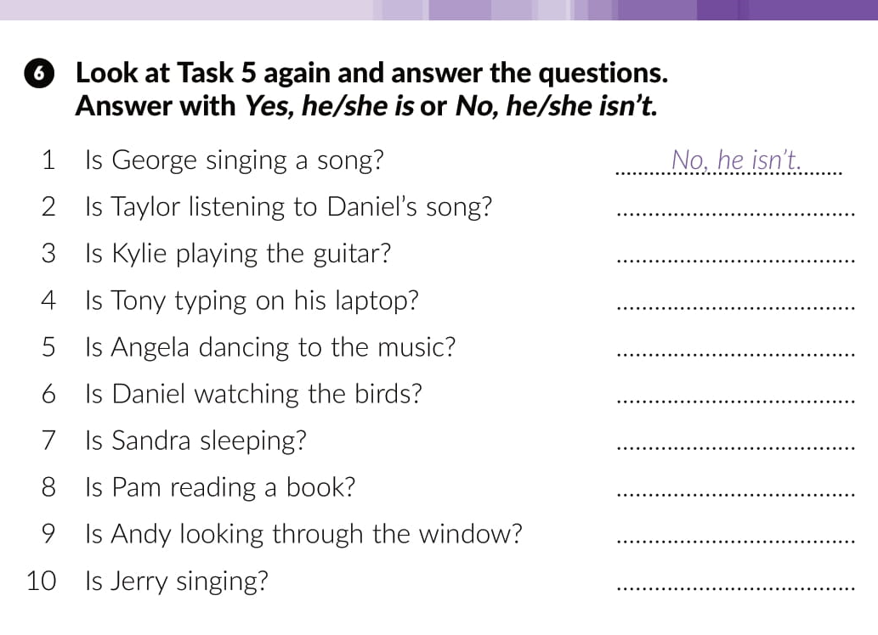
Yes, she is.
No, she isn’t.
Yes, he is.
Yes, she is.
No, he isn’t.
No, she isn’t.
Yes, she is.
No, he isn’t.
Yes, he is.

Slide 23
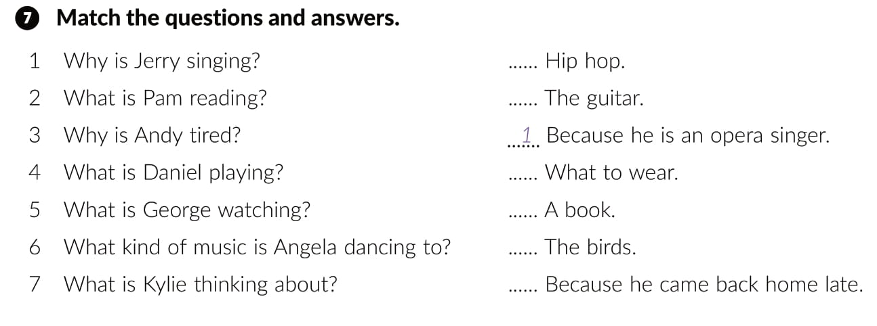
6
4
7
2
5
3

Slide 24
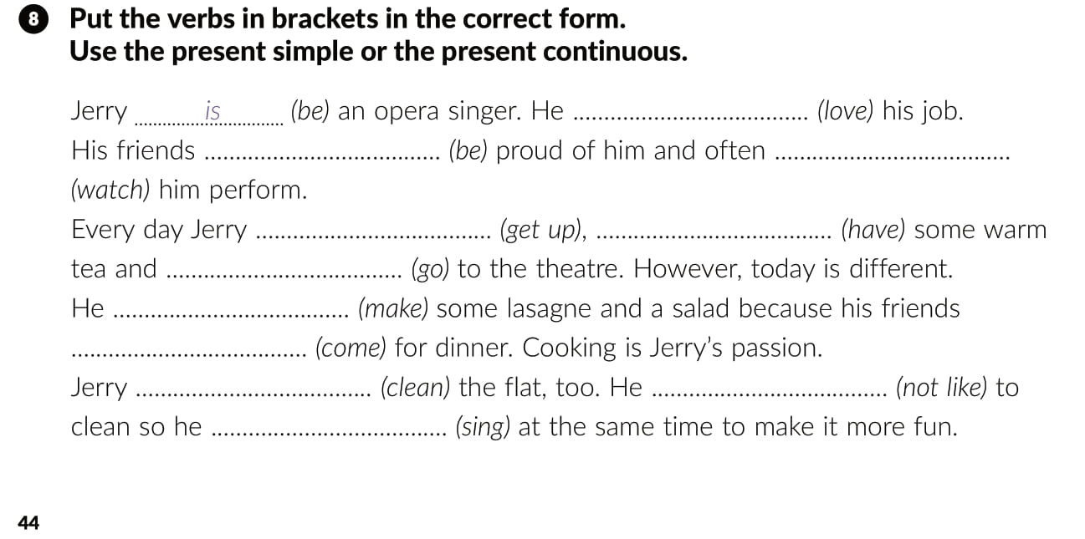
loves
are
watch
gets up
has
goes
is making
are coming
is cleaning
does not like
sings

Slide 25
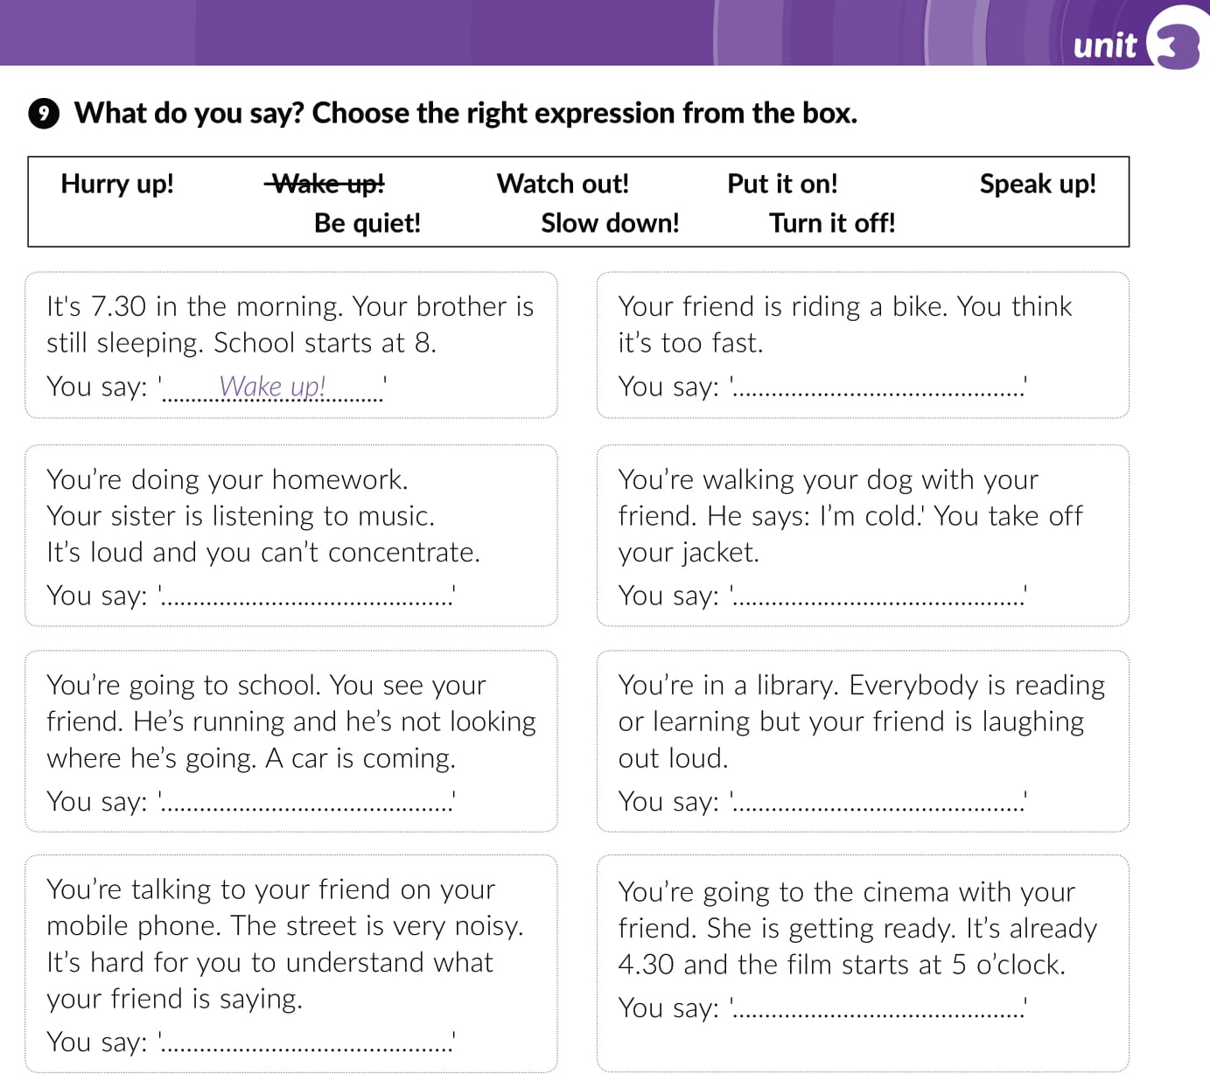
Slow down!
Turn it off!
Put it on!
Watch out!
Be quiet!
Speak up!
Hurry up!

Slide 26

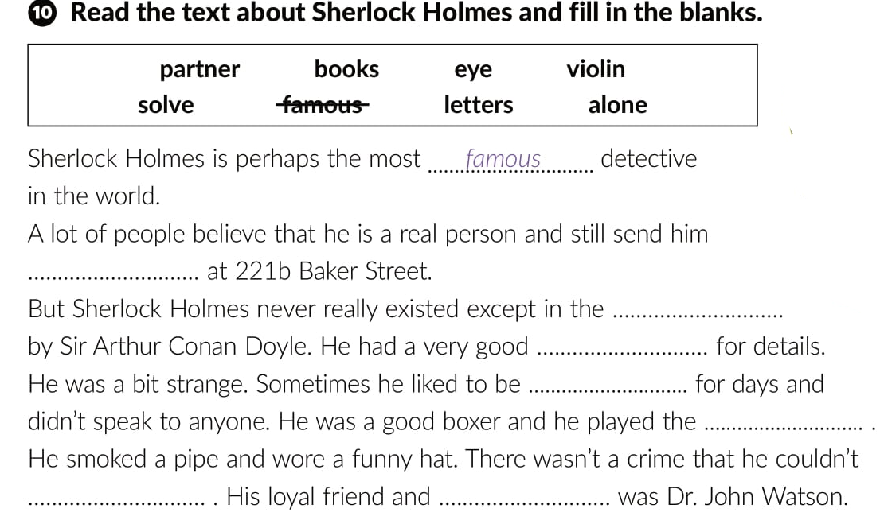
letters
books
eye
alone
violin
solve
partner

Slide 27

PLAY AND LEARN
Lesson 9 Whats your passion | Way to go 3 (e-sfera.hr)

